Slide 1
Visualize Website Click stream Data
Guide:
D.HARITHA
Team members: M.Samyuktha
2451-12-733-047

Slide 2
ABSTRACT
Click stream data is an information trail a user leaves behind while visiting a website. It is typically captured in semi-structured website log files. Hadoop makes it easier to analyze, visualize and ultimately change how visitors behave on the website. We can answer business questions such as:
What is the most efficient path for a site visitor to research a product, and then buy it?
What products do visitors tend to buy together, and what are they most likely to buy in the future?
Where should I spend resources on fixing or enhancing the user experience on my website?
We focus on the “path optimization” use case. Specifically: how can we improve our website to reduce bounce rates and improve conversion.

Slide 3
To VISUALIZE WEB SITE Click Stream DATA using Hadoop.
Problem Statement
Notes:
Notes: Every ecommerce business needs to track and analyse clickstream data to grow their business. Many analytics programs, including Google Analytics, come with basic clickstream analysis functionality. In Google it’s called as “site overlay”. There are so many solutions to deal with this issue. But by using traditional databases to load and process the clickstream data involves complexities while storing and streaming the customer’s information. And its take much processing time to analyse and visualize it. One way to solve this problem and improve performance is by using the structure of Hadoop which provides the large scale fast processing ecosystem environment. There are so many tools to provide this architecture in real time for enterprises. Here in this paper we use Hortonworks to load and process the sample clickstream data. And after analysing it, the data is visualized by power view tools to track the information.

Slide 4
Requirement Analysis
Software Requirement
Hardware Requirements
Horton works ODBC driver (64-bit)
Horton works Sandbox”
Microsoft Excel 2013 Professional Plus 64-bit
Windows 7 or later
Processor :Intel Pentium IV 2.1 GHz or above
Clock speed:500 MHz
RAM:128MB
HD:20 GB or higher

Slide 5
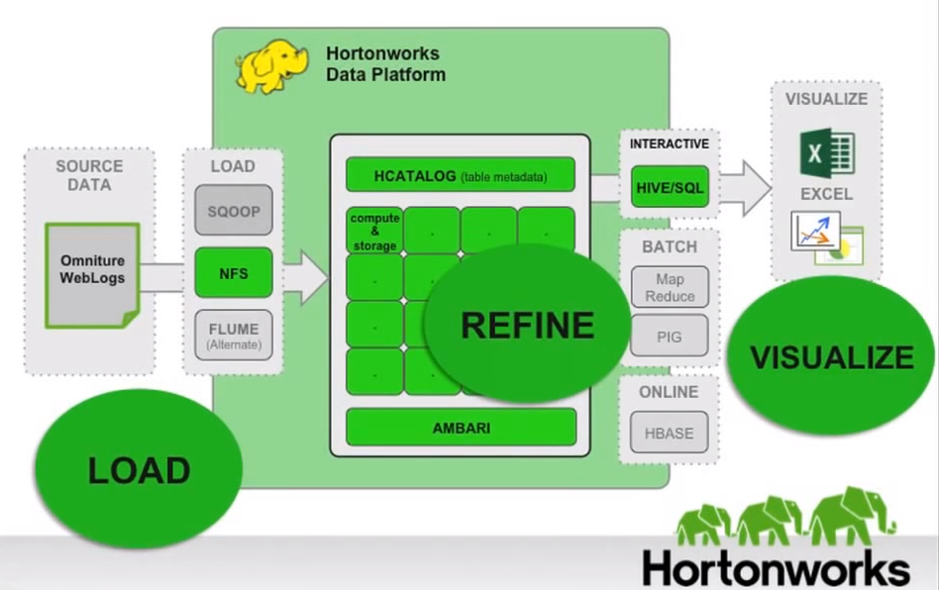
SYSTEM ARCHITECTURE

Slide 6
Proposed System
Data gathering
Extraction of weblogs
Storing and structuring data
Pattern matching and map reduce algorithm
HDFS
Data analysis
Data visualization

Slide 7
Scope
This enables analysts to make better insights to the websites for their business needs.
To predict
Session duration Web content
Url Traffic Volume
Bounce Rate Link Checking
This work can be enhanced to other BI tools to improve the sales and customer retention in all aspects.

Slide 8
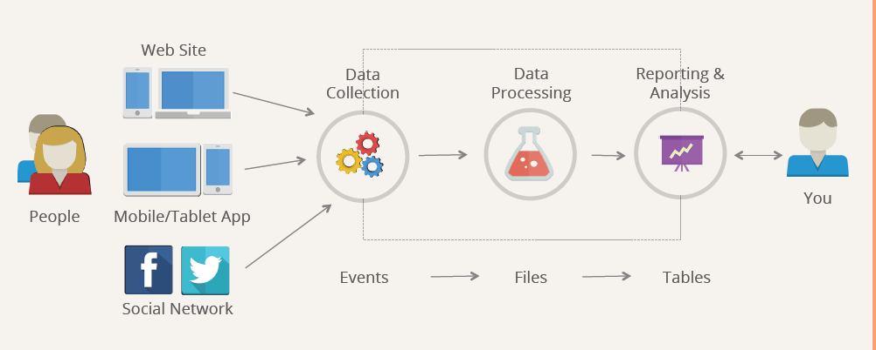
Click stream Analysis Generalized Approach
8

Slide 9
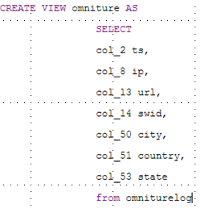
How does map reduce refine data?
Data has Volume, Variety and Velocity.
Process:
Input
Mapper class
Tokens(key,value)
Combine
Reducer class
Output

Slide 10
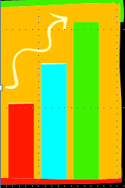
Visualize data Techniques
Load Data Excel
Extract Power set values
Choose data representation format

Slide 11

Conclusion: Why Websites ANALYSIS IS Important To Organizations
Finding weaknesses
Competitive practical analysis
Traffic Volume
Web Content
Keywords and Search Results

Slide 12
RefeReNcEs
https://www.bopdesign.com/bop-blog/2011/09/why-website-design-is-important/
http://www.huffingtonpost.com/john-rampton/business-mobile-responsive-design_b_5267077.html
http://blog.hubspot.com/marketing/paid-earned-owned-content-promotion
https://blog.kissmetrics.com/landing-page-design-infographic/?wide=1

